Slide 1

http://photopeach.com/album/fiwyli?ref=more
Kalkaska Middle School PLC
November 21, 2011
Notes:
Thanksgiving trivia is on link just for fun☺

Slide 2
Gallery walk
Rotate around each table, composing answers to questions as well as reflecting upon the answers given by others.
When signal is given, rotate to next table. Continue until all questions are addressed.
When you return to the original question, synthesize comments and prepare to “report out” to the larger group.
Notes:
How did you use the text annotation/text coding strategy in your classroom?
What roadblocks did you experience when implementing text annotating?
Describe how you used the It Says-I Say-And So strategy? If you did not utilize the strategy, explain why.
Describe the print resources you used when implementing the two strategies.
What kinds of tools, materials, or training would you need to better understand the CCSS in Reading for your content area?

Slide 3
“The world is passing through troublous times. The young people of today think of nothing but themselves. They have no reverence for parents or old age. They are impatient of all restraint. They talk as if they knew everything, and what passes for wisdom with us is foolishness with them. As for the girls, they are forward, immodest and unladylike in speech, behavior, and dress.”
-Peter the Hermit, 1274
Notes:
For those of us who work in middle and high schools, the times have ever been and will always be troublous. That trouble is some of the best parts of teaching. The challenge is to help the teenagers care about living literate lives. Threatening them with the dire consequences of performing poorly on tests doesn’t achieve the results. Demonstrating the intellectual pleasures to be had in the company of good books does.

Slide 4
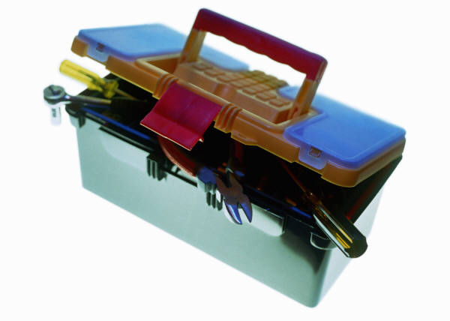
Refocus: Let’s get back in the Ccss!
Locate your standards document, p. 39
Locate informational text exemplars for grades 6-8
Locate the Depth of Knowledge chart
Notes:
These are the tools that you will need to complete the “analyzing a standard” activity!
1. Standards documents are copies for all grades (K-12)

Slide 5
Re-energize: citing text evidence
Locate the “Charity Means You Don’t Pick and
Choose” article.
Read and try to determine what the central question is that the author wants us to consider.
Using the graphic organizer, revisit the essay and find the pros and cons.
Revisit the essay a 3rd time to find specific details (evidence) to support the argument.
Given the weight of the arguments on both sides, determine the author’s answer to the question, “Should we give handouts to the homeless?”
Notes:
The “Charity Means You Don’t Pick and Choose” article actually originated from Newsweek which has a My Turn section in every issue. This is an excellent modeling source for argument writing. Newsweek and The Daily Beast merged in November, 2010 to form the Newsweek Daily Beast (name of the fictitious paper in Evelyn Waugh’s The Scoop)
For question 5, paraphrase the answer by citing a line from the piece and writing it beside “Author’s Thesis” at the bottom of the graphic organizer.
Having our students examine real-world writers helps them to see the craft of good writing. Let’s face it, our students will not be spending the rest of their lives reading Beowulf, but hopefully, they will spend their adult lives reading books and magazines. By getting them to analyze real world text, not only are we preparing them for their adult reading lives, but we are also providing them with interesting, relevant models. (Kelly Gallagher)

Slide 6
Finding free articles
http://www.procon.org/
http://theweek.com/
Notes:
ProCon.org: free. Organized by subject area and for many of the topics, you can click to related pages. Each topic also contains a one minute overview that provides background knowledge for the issue in clear, easy to read language. With a click, you can review an “expanded background” for each topic. Below this overview are 9-10 short argumentative paragraphs in each of two columns (pro and con) Each summarizes the important facts or conclusions from one article, citations for each article are listed below. These provide students with abundant opportunities to learn essential content, read closely to make inferences, synthesize competing claims, analyze arguments, and reach conclusions.
The Week: A relative newcomer in the weekly newsmagazine category. Usually one page or shorter in length. Science: What’s in the McRib anyway? Can a killer solar flare really destroy earth?

